Slide 1
RABIN-KARP
ALGORITHM
-DAA

Slide 2
Introduction :
Rabin-Karp algorithm is an algorithm used for searching/matching patterns in the text using a hash function.
It does not travel through every character in the initial phase rather it filters the characters that do not match and then performs the comparison.

Slide 3
Problem:
Given two strings, one is a text string and the other is a pattern string. The task is to print the indexes of all the occurrences of the pattern string in the text string. For printing, the starting index of a string should be taken as 1. The strings will only contain lowercase English alphabets (‘a’ to ‘z’).

Slide 4
EXAMPLE:
Given Text = 315265 and pattern = 26
We choose b = 11
P mod b = 26 mod 11 = 4
3 | 1 | 5 | 2 | 6 | 5
3 | 1
31 mod 11 = 9
not equal to 4
3 | 1 | 5 | 2 | 6 | 5
15 mod 11 = 4 equal to 4 ->
Spurious hit

Slide 5
3 | 1 | 5 | 2 | 6 | 5
52 mod 11 = 8
not equal to 4
3 | 1 | 5 | 2 | 6 | 5
26 mod 11 = 4 equal to 4 ->
an exact match!!
3 | 1 | 5 | 2 | 6 | 5
65 mod 11 = 10
not equal to 4
As we can see, when a match is found, further testing is done to ensure that a match has indeed been found.

Slide 6
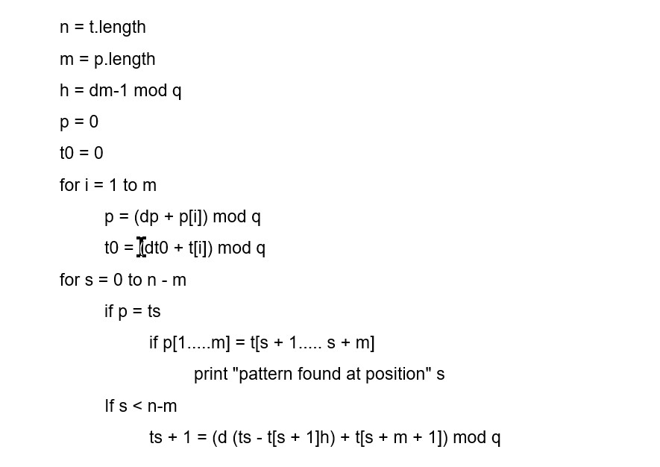
Algorithm :

Slide 7
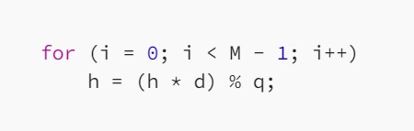
1) Hash Factor :

Slide 8
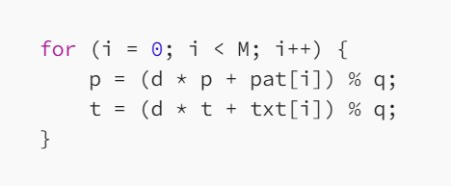
2) Calculate Initial Hash Values :

Slide 9
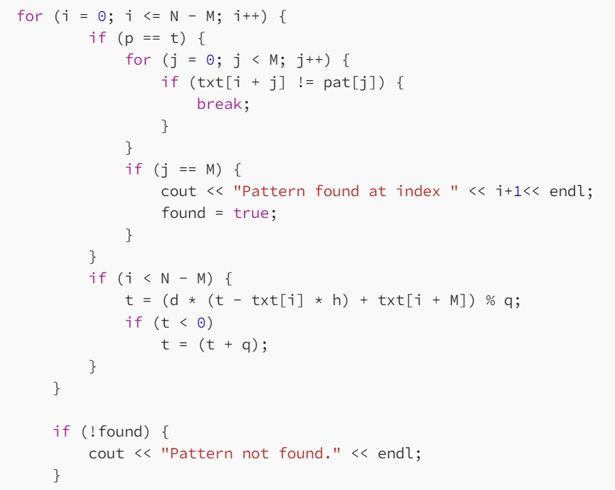
3) Search for Pattern in Text :

Slide 10
Limitations :
Spurious Hit
When the hash value of the pattern matches with the hash value of a window of the text but the window is not the actual pattern then it is called a spurious hit.
Spurious hit increases the time complexity of the algorithm. In order to minimize spurious hit, we use modulus. It greatly reduces the spurious hit.

Slide 11
Time Complexity :
The average case and best case complexity of Rabin- Karp algorithm is O(m + n) and the worst case complexity is O(m*n).
The worst-case complexity occurs when spurious hits occur a number for all the windows.

Slide 12


